Slide 1
ASM NGS Pre Conference NCBI Workshop Background Information - Part 2: NCBI in the Cloud
Hosted by NCBI Pathogen Detection Team

Slide 2
II. NCBI in the Cloud
NIH STRIDES Initiative
SRA in the cloud
SRA toolkit
Metadata via BigQuery
Sars-Cov2 Dataset in AWS
ElasticBLAST
Annotation pipelines
PGAP
RAPt

Slide 3
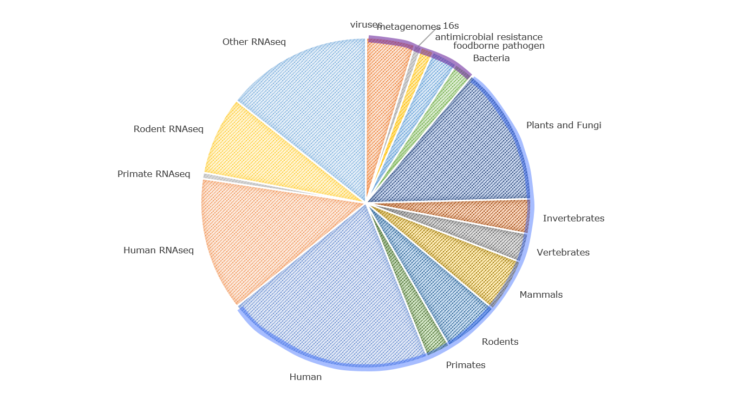
Public SRA 5PB
Prokaryote &
Metagenome
10%
RNAseq
40%
Genomes
50%

Slide 4
The scale of data is growing
1. What tools will be needed to provide meaningful access to the growing amount of genomes and other sequences.
2. Blast interfaces are becoming problematic with growing genome databases.
3. Metagenomic data: characterization and isolation of genes without reference to species.

Slide 5
Need for the STRIDES Initiative
The NIH Science and Technology Research Infrastructure for Discovery, Experimentation, and Sustainability (STRIDES) Initiative allows NIH to explore the use of cloud environments to streamline NIH data use by partnering with commercial providers. NIH’s STRIDES Initiative provides cost-effective access to industry-leading partners to help advance biomedical research. These partnerships enable access to rich datasets and advanced computational infrastructure, tools, and services.
https://commonfund.nih.gov/strides
https://datascience.nih.gov/strides

Slide 6
SRA in the Cloud
https://www.ncbi.nlm.nih.gov/sra/docs/sra-cloud/
SRA data is available in the cloud
- requires SRA Toolkit to be installed -
this has already been done for you for the workshop and we will run through some examples
Metadata is available via BigQuery
we will NOT run through some examples during the workshop
STAT analysis results are available via BigQuery
we will run through some examples during the workshop
YouTube Tutorial Series
https://www.youtube.com/playlist?list=PLH-TjWpFfWrt5MNqU7Jvsk73QefO3ADwD

Slide 7
SRA Toolkit
There are detailed instructions on downloading and installing the SRA toolkit
There are brief videos available that also explain how to do this
For the workshop we have installed the SRA toolkit, but we will need to configure
each users's installation, which we will do during the workshop
The rest of these slides are provided as background info
https://github.com/ncbi/sra-tools/wiki

Slide 8
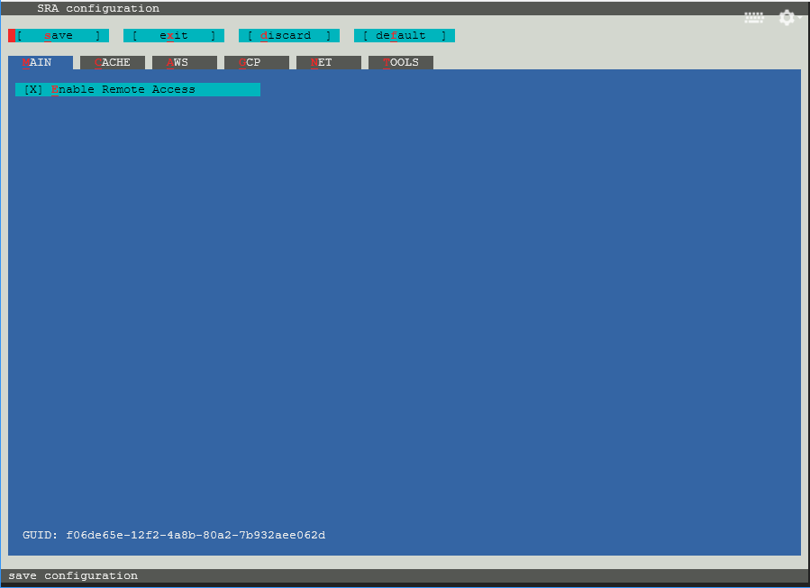
SRA Toolkit configuration
The final step to getting the toolkit installed will be to run vdb-config program to configure our toolkit install.
vdb-config -i
This will open a graphical user interface (GUI) to set some required parameters.
We can navigate the menus by typing the letter highlighted in red on the screen to move between the menus and set options.

Slide 9
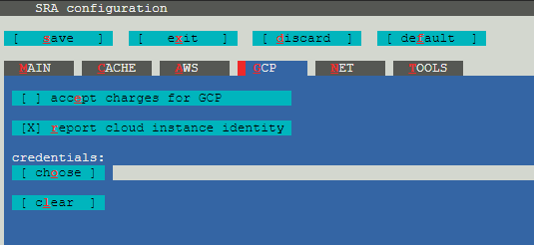
SRA Toolkit configuration
Type r to report the cloud instance identity to the toolkit. The information provided with this is the cloud provider and region.
Type s to save the configuration. Type o to confirm.
Type x to exit the configuration.
We have finished configuring the SRA Toolkit for accessing data on a GCP VM.

Slide 10
Pull In Data with SRA Toolkit
To test our configuration, we’ll try accessing a sequencing data run from SRA.
prefetch SRR000001
We should see several lines of information appear on the screen with the last line telling us we have downloaded the data successfully.
If we list the directory SRR000001 we will see the downloaded data file in the directory.
ls SRR000001

Slide 11
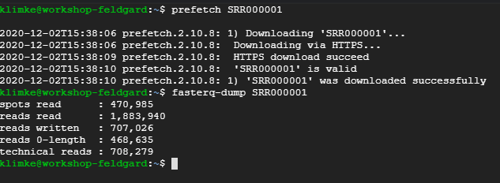
Output FASTQ with SRA Toolkit
We can also use the SRA Toolkit to convert the data we downloaded into other formats, like fastq.
We will use the fasterq-dump program to produce fastq data. This program has many options but if we run with the default choices it will output a fastq file for each read in a paired data set.
If there are unmated reads in the run it will output a third file with just the unmated reads.
fasterq-dump SRR000001

Slide 12
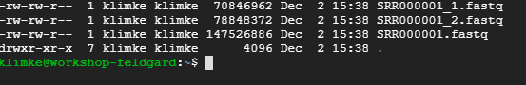
SRA Toolkit FASTQ Output
There were three files produced from this operation
SRR000001.fastq SRR000001_1.fastq SRR000001_2.fastq
The first file is the unmated reads while the files with the _1 and _2 are the mated reads.

Slide 13
Overview
What is BigQuery?
Pinning Data in the Console
Search SRA Metadata
Taxonomy Searches of SRA

Slide 14
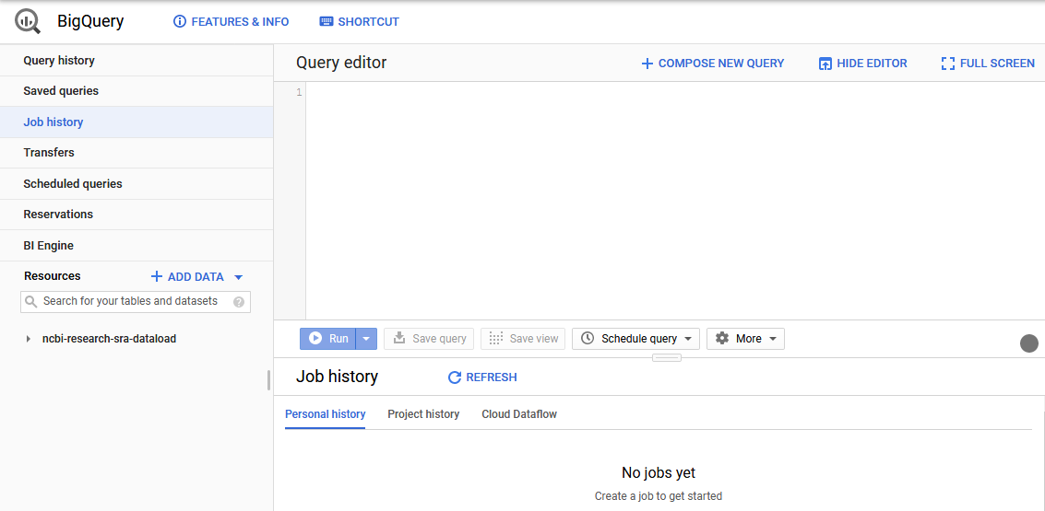
What is BigQuery?
BigQuery is the Google Cloud Data Warehouse product.
It supports features like queries, access control, and data management.
The Sequence Read Archive (SRA) maintains a copy of the sequence metadata from submissions in BigQuery
This allows SQL queries to search the metadata in ways that are hard or impossible with the NCBI Entrez search engine.
https://cloud.google.com/bigquery/docs/how-to

Slide 15
Intro to BigQuery
Like bucket creation you can either use a client from Google in a vm (bq) or the GCP console in a web browser.
For this demo we will only be using the browser console.

Slide 16
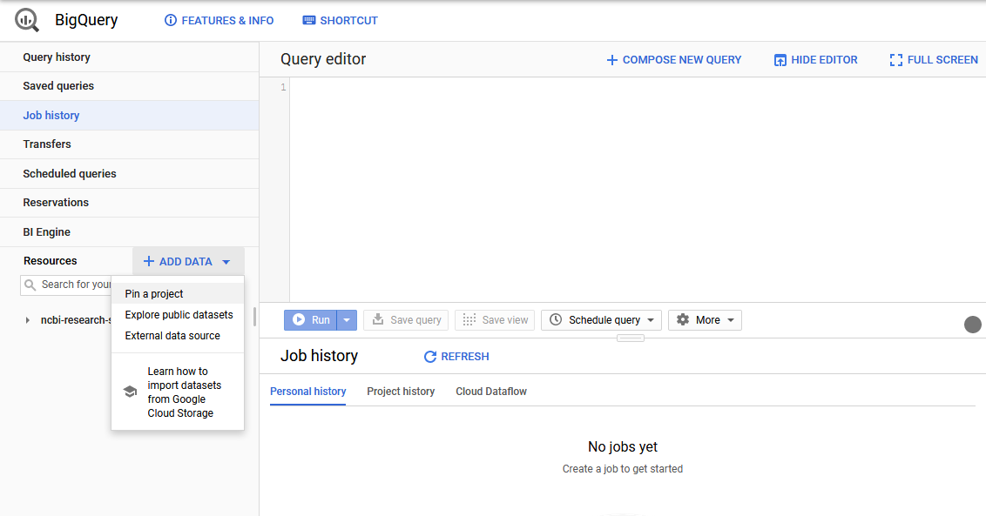
Adding Data
We will add the public SRA data set to our BigQuery project.
Click + ADD DATA on the left side of the console.
In the menu that appears click Pin a project.

Slide 17
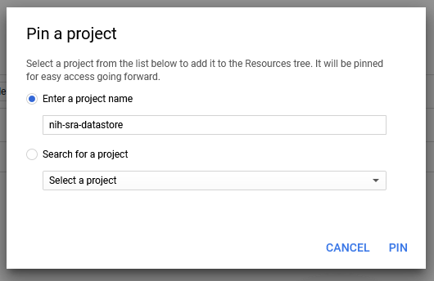
Adding Data
Enter nih-sra-datastore in the project name box.
Click PIN.
This will pin the public metadata datastore to your BigQuery console.

Slide 18
Simple SQL Queries
A very basic overview of SQL queries.
SELECT – command to extract data from a table.
FROM – specify which tables to extract data from
WHERE – filters the data
ORDER BY – order the results by specified column(s)
https://cloud.google.com/bigquery/docs/reference/standard-sql/query-syntax

Slide 19
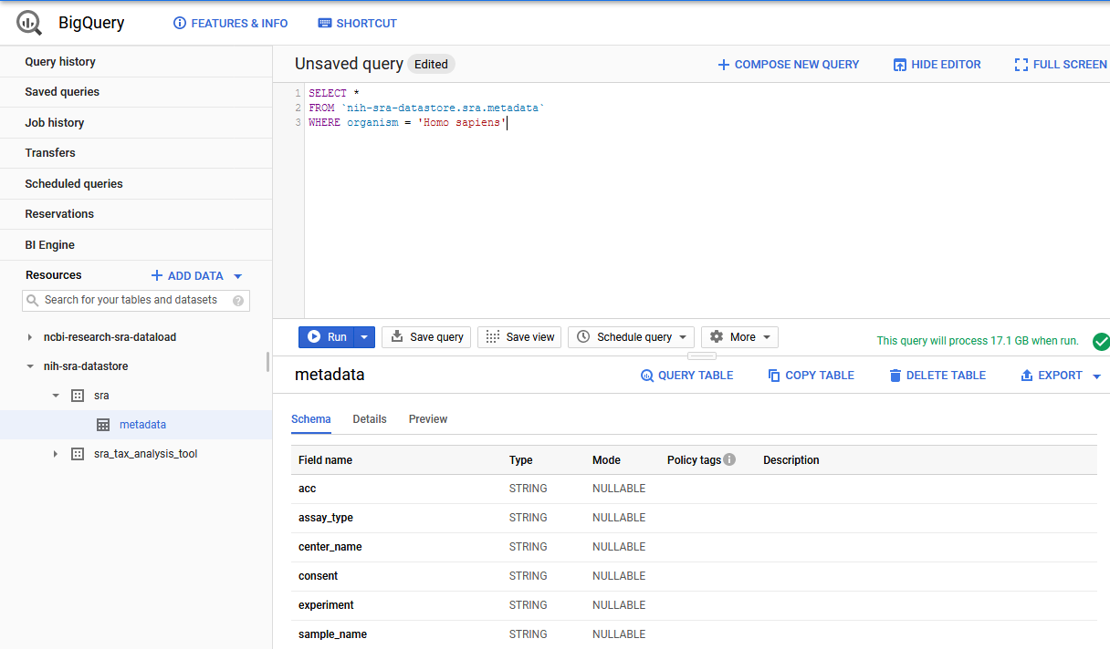
Searching in BigQuery
Here is an example search for the SRA Data.
SELECT * FROM `nih-sra-datastore.sra.metadata` WHERE organism = ‘Homo sapiens’
This query will search in the metadata table that is part of the SRA dataset contained in the nih-sra-datastore project.
The query will look for all (Select *) records with ‘Homo sapiens’ in the organism column.

Slide 20
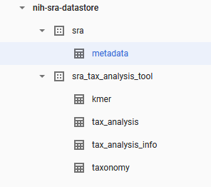
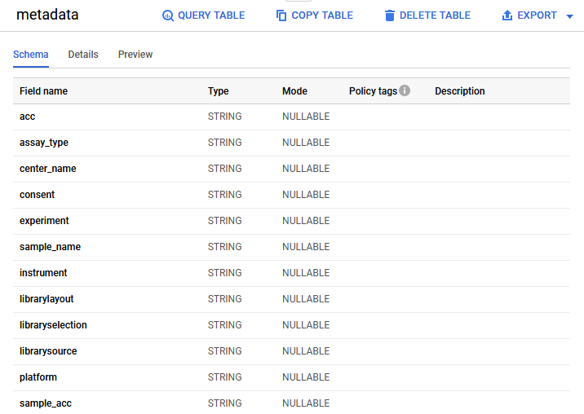
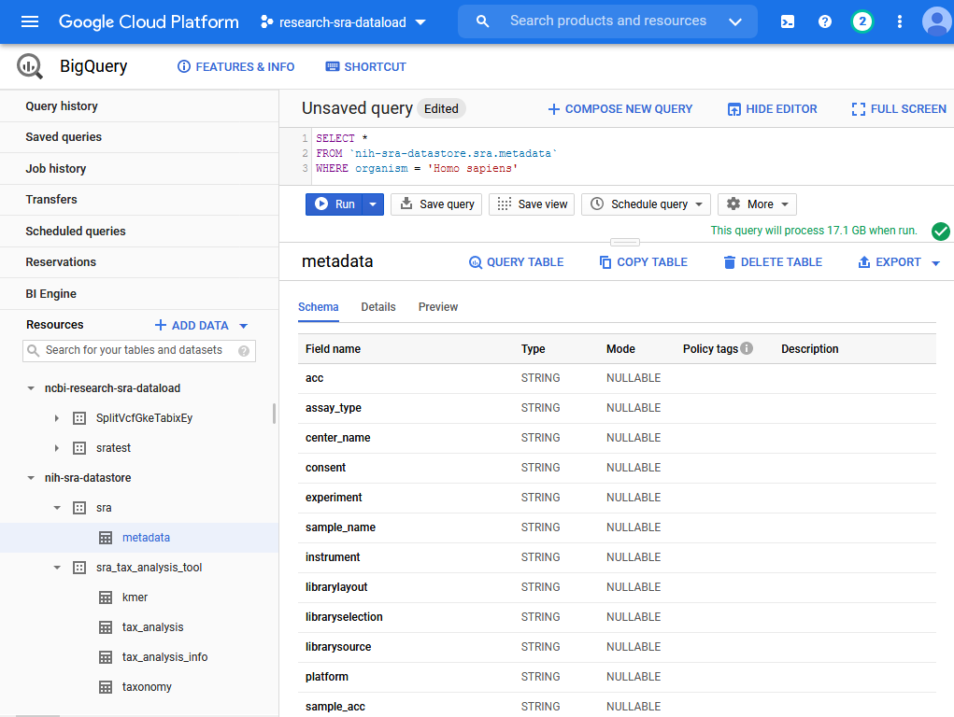
Console Previews and Info
The console has some very useful features we can explore.
We can look through the tables available to query in the pinned dataset.
By clicking on a single table we can view the columns and data type of those columns.

Slide 21
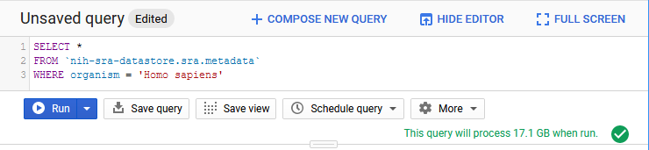
BigQuery Charges
We also get a preview of how much data will be searched.
Our example query will look through 17.1 GB of data to get a result.
This is one of the ways you generate cost in BigQuery
https://cloud.google.com/bigquery/pricing
Our example is an on-demand query which currently costs $5.00 per TB searched.
This query would be ~$0.10 to run
The first 1 TB each month is free.

Slide 22
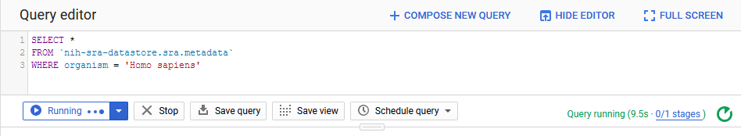
Running a Query
Click RUN to run the query.
While the query is running the console will show live updates on the status of the query.
Once the query finishes the results will display in the lower right portion of the console.

Slide 23
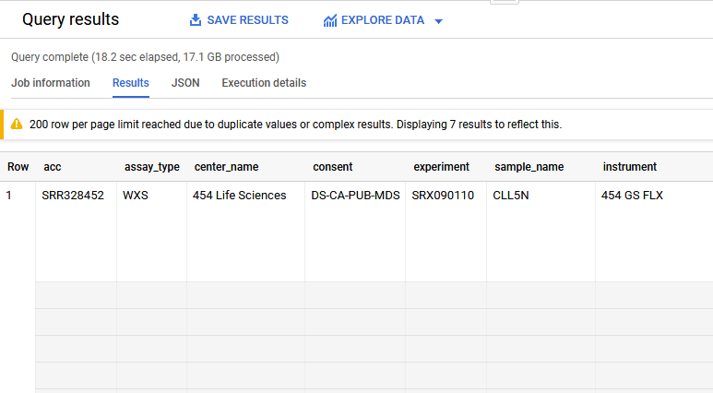
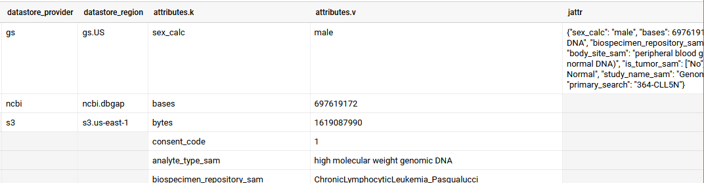
BigQuery Arrays
You might expect to see one record per row on the results but BigQuery supports an array feature for multi-value fields.
Scrolling to the right on this record we can find several columns that have multiple lines for this one record.
We won’t go into depth on the data structure in these columns but it is an important feature of BigQuery

Slide 24
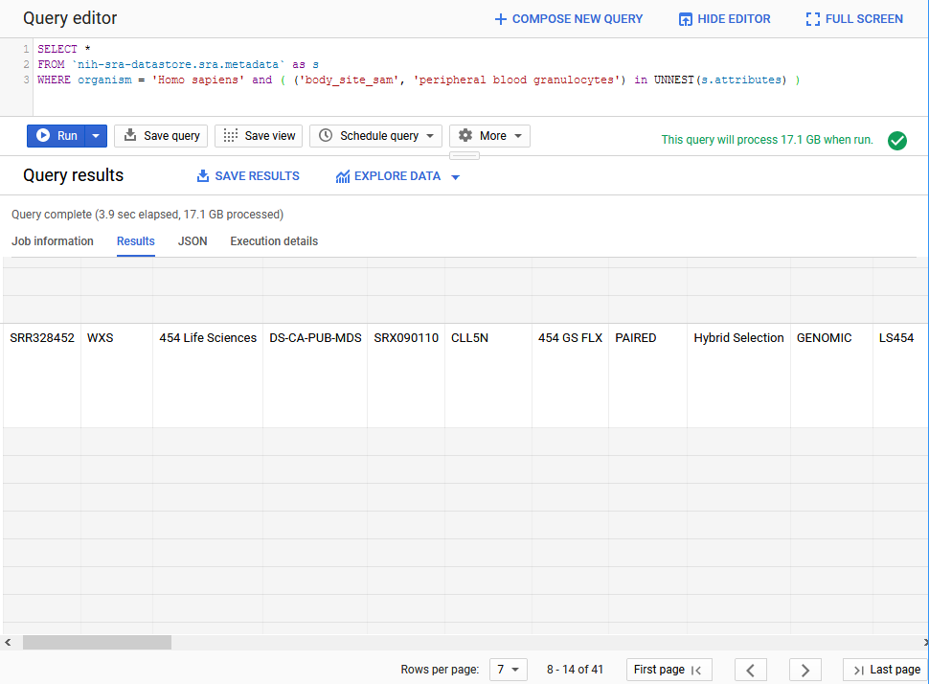
Unnesting Arrays
Here is an example search that will filter for a value in one of those columns.
SELECT *
FROM `nih-sra-datastore.sra.metadata` as s
WHERE organism = 'Homo sapiens' and ( ('body_site_sam', 'peripheral blood granulocytes') in UNNEST(s.attributes) )
The unnest function is allowing us to search the key ‘body_side_sam’ and find only records with the value ‘peripheral blood granulocytes’

Slide 25
Taxonomy Data
In addition to metadata from the SRA database, there is also the sra_tax_analysis_tool dataset.
There are four tables in this dataset:
tax_analysis_info: a summary table for the results of the STAT tool
tax_analysis: use the taxonomy analysis table to locate any number of runs based on kmer hits to a particular organism or branch in a taxonomic tree.
taxonomy: NCBI Taxonomy database where you can locate the taxid based on organism names.
kmer: contains kmers mapped to a particular organism and allows you to continue exploring organismal content further. You can use kmer tables in your downstream analysis by building custom kmer libraries.

Slide 26
Searching in BigQuery
We can join the metadata and the taxonomy data and to search for sequence data in SRA that is from the coronaviridae family.
SELECT m.bioproject, m.biosample, m.acc, m.collection_date_sam, m.geo_loc_name_sam,
(select v from unnest(m.attributes) where k = 'collected_by_sam') as collected_by,
(select v from unnest(m.attributes) where k = 'host_sam') as host
FROM `nih-sra-datastore.sra.metadata` m , `nih-sra-datastore.sra_tax_analysis_tool.tax_analysis` tax
WHERE m.acc = tax.acc
and tax.name = 'Coronaviridae'

Slide 27
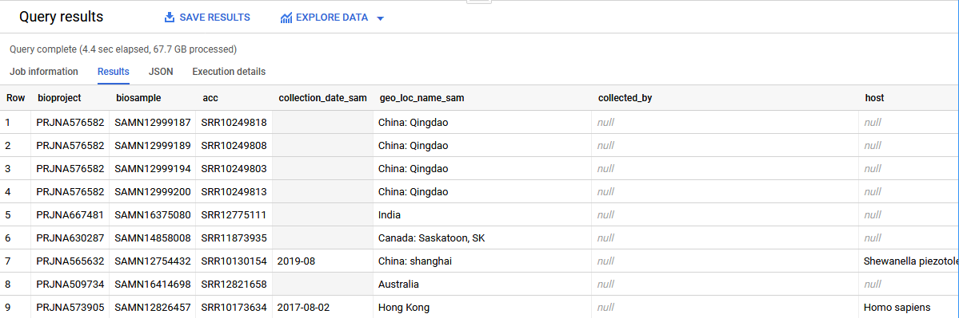
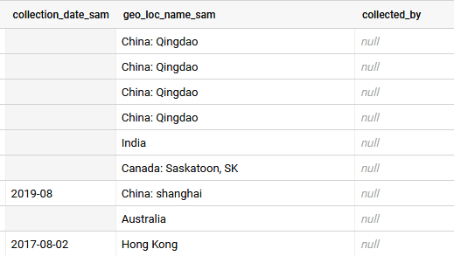
Searching in BigQuery
This query includes the project, sample, and run accessions for all the data we found. It also shows submitter supplied metadata for date, location, host, and collected by fields.
Note that some of this metadata might not have been provided by the submitter so the presence of certain metadata on one record does not imply it will be present on all records.
Keep that in mind when writing queries.

Slide 28
Searching in BigQuery
The last query was part of this NCBI Minute webinar on using BigQuery
https://www.youtube.com/watch?v=DkNz-RCCm-M
The NCBI YouTube channel has additional videos on many topics that range in length from a few minutes to over an hour long.
https://www.youtube.com/channel/UCvJHVo5xGSKejBbBj0A5AyQ

Slide 29
Review
BigQuery allows for SQL searches of large data sets quickly.
BigQuery can be used to search the publicly accessible SRA metadata using SQL searches.
SRA has generated taxonomy data using the SRA Taxonomy Analysis Tool (STAT) that can be used to find the organism content of runs in SRA.

Slide 30
Additional Resources
STAT Description https://www.ncbi.nlm.nih.gov/sra/docs/sra-taxonomy-analysis-tool/
Additional Examples for SRA Searches in BigQuery https://www.ncbi.nlm.nih.gov/sra/docs/sra-bigquery-examples/
Google Quickstart for BigQuery https://cloud.google.com/bigquery/docs/quickstarts/quickstart-web-ui
A video from Google that looks at nested data in BigQuery https://www.youtube.com/watch?v=STo98QUKDS8

Slide 31
Sars-Cov2 data in AWS
A centralized sequence repository for all strains of novel corona virus (SARS-CoV-2) submitted to the National Center for Biotechnology Information (NCBI). Included are both the original sequences submitted by the principal investigator as well as SRA-processed sequences that require the SRA Toolkit for analysis.
https://registry.opendata.aws/ncbi-covid-19/
this topic will not be covered during the workshop

Slide 32
Additional Resources
SRA in the cloud
Webinar
https://youtu.be/PoseTXa8LU8
Materials
https://ftp.ncbi.nlm.nih.gov/pub/education/public_webinars/2020/04Apr08_SRA_Cloud
BigQuery
https://youtu.be/DkNz-RCCm-M
Materials
https://ftp.ncbi.nlm.nih.gov/pub/education/public_webinars/2020/05May20_BigQuery/
Cloud Access Costs
https://www.ncbi.nlm.nih.gov/sra/docs/sra-cloud-access-costs/

Slide 33
Acknowledgements SRA/STRIDES Team
Lydia Fleischmann
Carl Leubsdorf
Brad Plecs
Thomas Doak
Kate Mortensen
Layla Freeborn
Sheri Sanders
Rodney Brister
Ryan Connor
Ravinder Eskandary
Allie McDougall
Rana Morris
Daniel Soren
Louise To
Tom Madden
Chistiam Camacho
Françoise Thibaud-Nissen
Dave Arndt
Rick Lapoint
Chris O’Sullivan
Yuriy Skripchenko
Jon Trow
Steve Sherry
This research was supported by the Intramural Research Program of the NIH, National Library of Medicine.

Slide 34
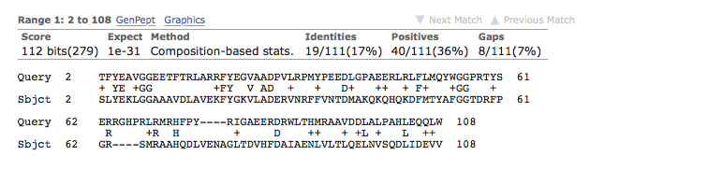
What is BLAST?
Basic Local Alignment Search Tool
Calculates similarity for biological sequences.
It produces local alignments. Only a portion of each sequence must be aligned.
Use statistical theory to determine if a match might have occurred by chance.

Slide 35
What is Elastic-BLAST?
Elastic-BLAST is a command line tool to align large numbers (millions of bases/residues) of nucleotide and protein sequences against BLAST databases.
Elastic-BLAST implements best practices for searching on the cloud so you can concentrate on science.

Slide 36
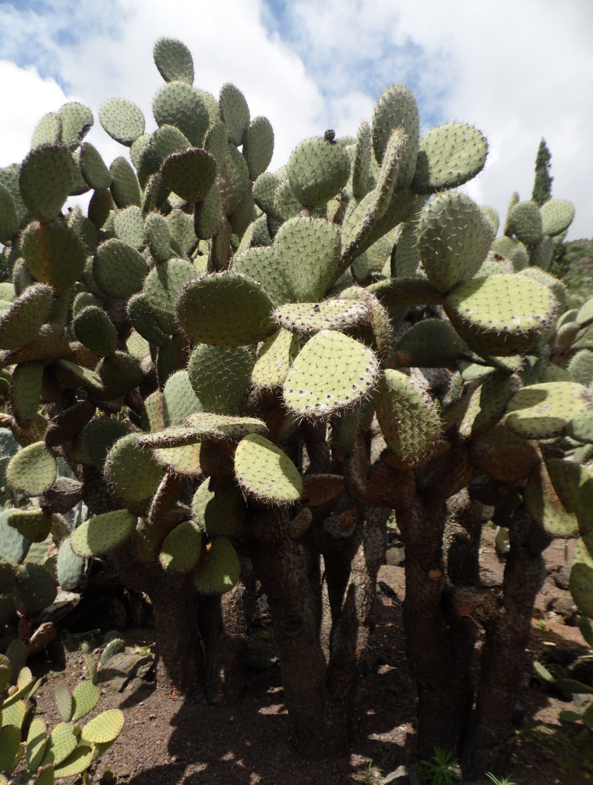
An Elastic-BLAST application
Annotation of mRNA transcripts with functional and biological processes
BLAST is used to align an assembled transcriptome against annotated databases of proteins or nucleotides.
blastp open reading frames against non-redundant database (nr)
rpsblast open reading frames against Conserved Domain Database (cdd)
blastn transcripts against nucleotide database (nt)
rpstblastn transcripts against CDD database
Example annotation project:
Opuntia streptacantha (nopal) transcriptome (PRJNA320545): 474,563 transcripts (217 million base pairs)

Slide 37




Several components to Elastic-BLAST
Containerized version of BLAST
An orchestration program
BLAST Databases
Your queries
Your BLAST options

Slide 38
BLAST in Docker
Use docker because:
It provides isolation between application and machine it’s on
It works well with orchestration packages like Kubernetes
It’s easy to install an image
Dockerized the BLAST+ command-line executables
Works with databases hosted on cloud providers
Docker is a type of container. Singularity is another.

Slide 39
Kubernetes
Open-source package to orchestrate containers
Used by Elastic-BLAST to start and stop instances, download databases, and schedule work.
Often written as k8s since “ubernete” is 8 letters

Slide 40
BLAST Databases at AWS and GCP
Currently 26 databases.
Same databases at the NCBI FTP site and the cloud providers.
Examples
Refseq Eukaryotic Representative Genomes
16S database based on Targeted Loci.
Human and mouse genomes
Full list:
https://github.com/ncbi/blast_plus_docs#blast-databases

Slide 41
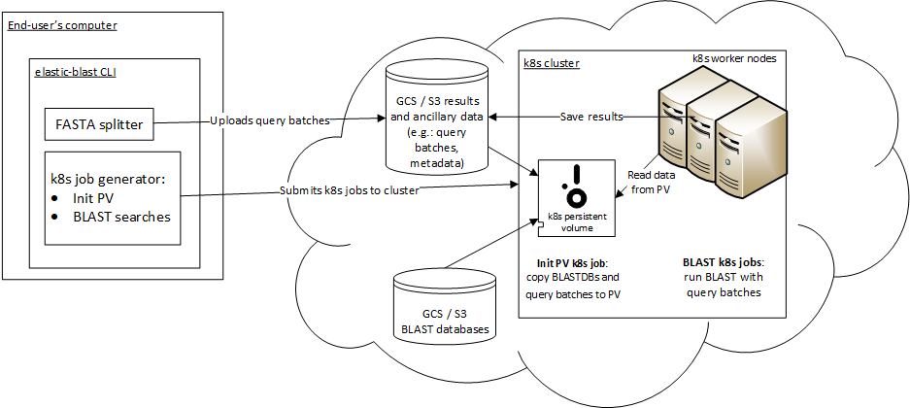
ElasticBLAST architecture
Notes:
Technologies:
K8s
Docker BLAST+
Python CLI app
Cloud: object storage, block storage

Slide 42
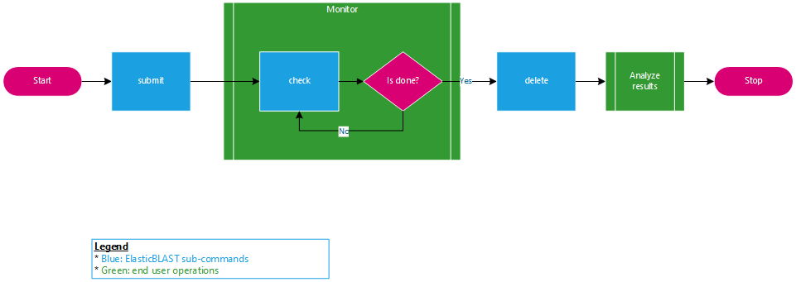
How to use Elastic-BLAST?
Visit the quick start! https://elbdoc.readthedocs.io/

Slide 43
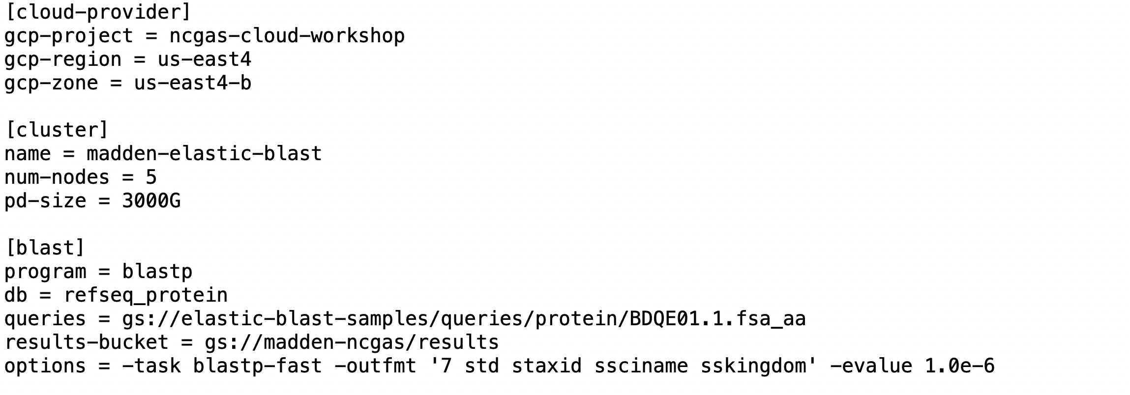
Example config file for Elastic-BLAST
Set once, leave alone
Can be mostly left alone, but change if a different number or size of nodes (machines) are desired
BLAST specific

Slide 44
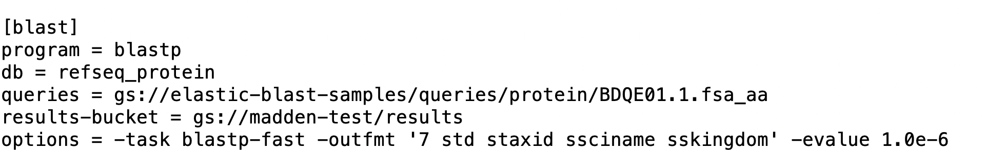
BLAST part of config file
BLASTP (protein-protein) command-line:
Output format
Expect value

Slide 45
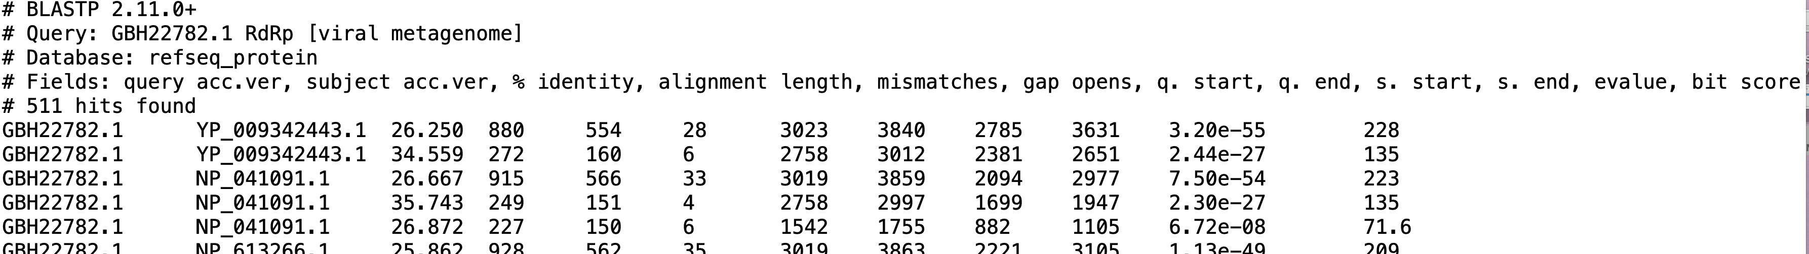
Formatting Options
The –outfmt flag can be used with the argument 6, 7 or 10 to produce tabular or comma delimited output. Additionally, it is possible to specify which fields should be shown. The examples below demonstrate some different reports that can be formatted.
Output for –outfmt 7. Only –outfmt 7 has the header information (lines starting with #). -outfmt “7 std” produces the same report.

Slide 46
Adding Fields to the Standard Set
-outfmt “7 std” specifies the ”standard” fields in the report. Other fields can be added after the standard ones
Output from –outfmt “7 std sskingdom” The standard (“std”) fields are:
‘qaccver saccver pident length mismatch gapopen qstart qend sstart send evalue bitscore'

Slide 47
Comma-delimited Custom Output
Output from -outfmt "10 sacc slen staxids sscinames”. Completely custom output can also be created with -outfmt 6 and 7
See also: https://www.ncbi.nlm.nih.gov/books/NBK279682/

Slide 48
Expect Values
The number of alignments expected by chance with a given score
The larger the database, the more alignments are expected at a given score
“Errors per Query” or “FALSE Positive rate”
For small expect values (less than 0.01), the expect value and p-value are approximately the same.
Also https://www.ncbi.nlm.nih.gov/BLAST/tutorial/Altschul-1.html

Slide 49
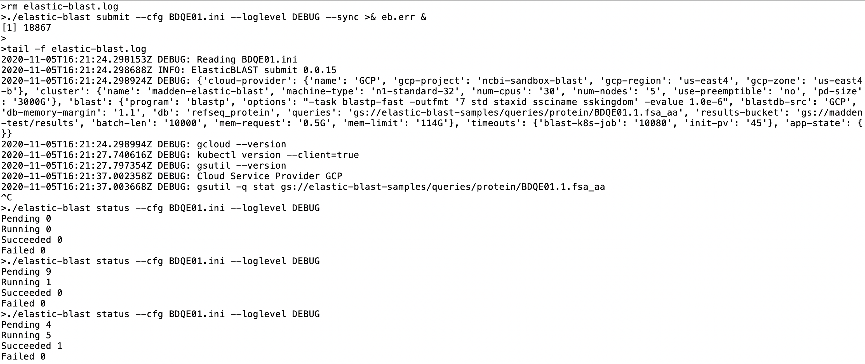
Start a Search

Slide 50
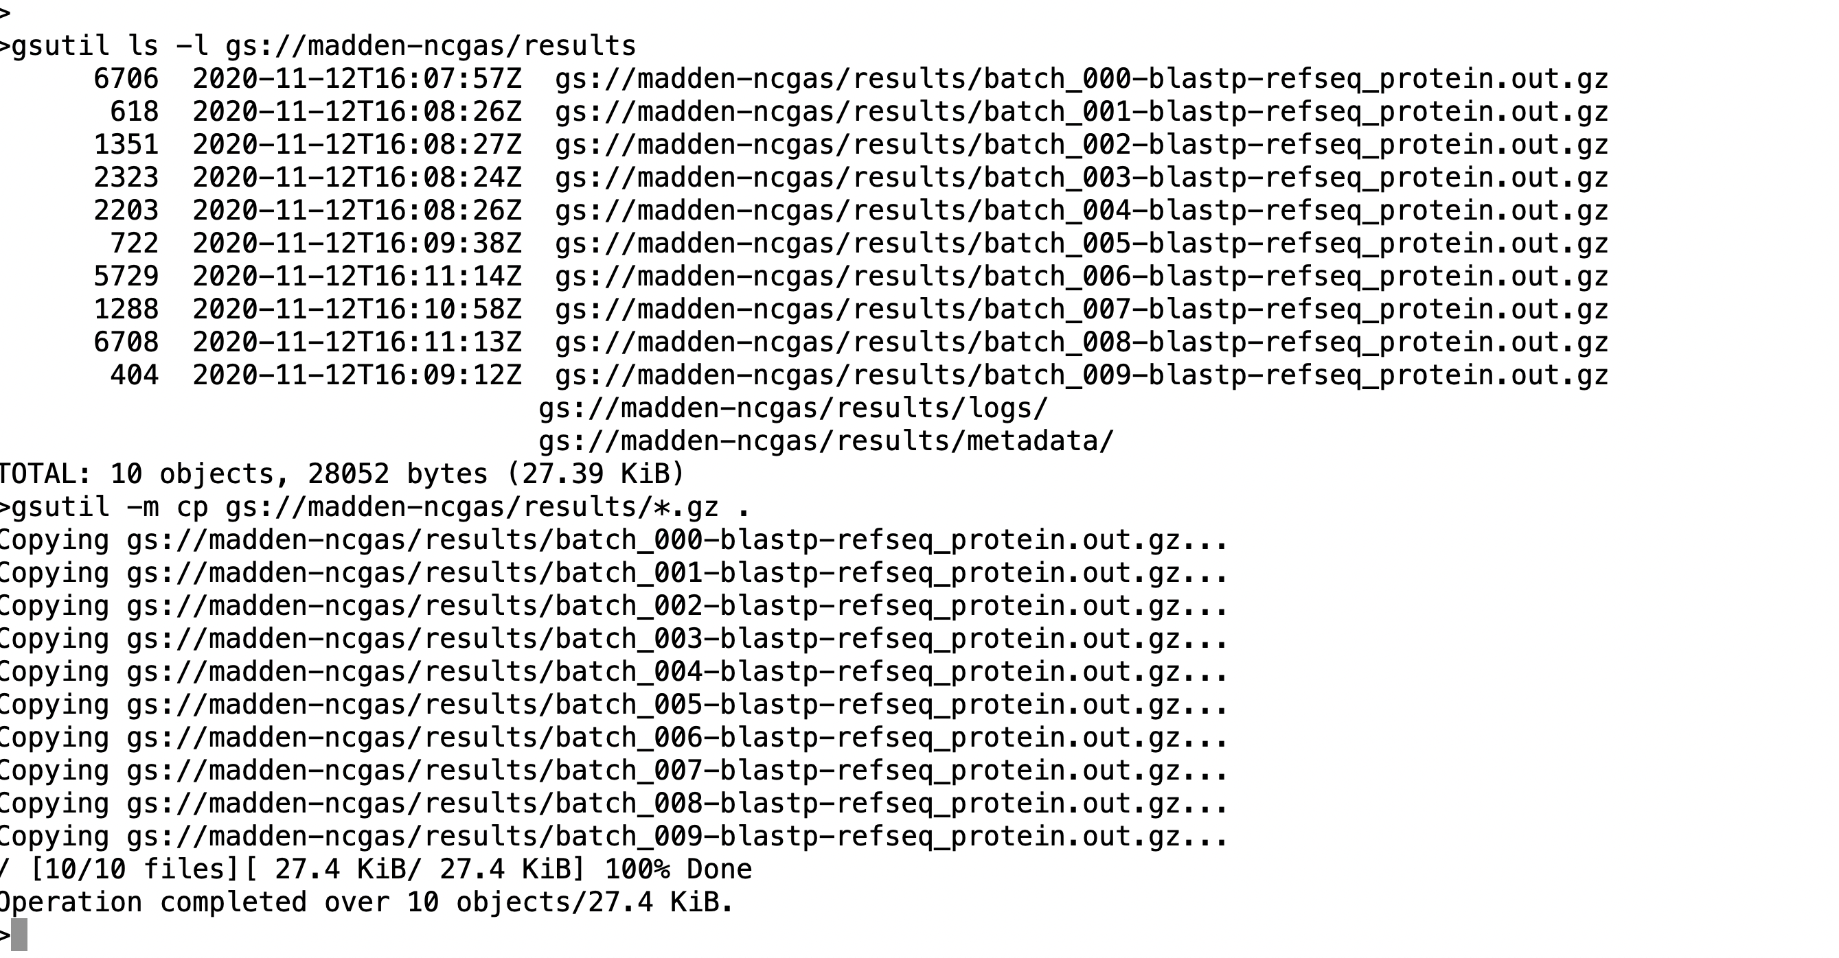
Accessing Results

Slide 51
Using the console to see CPU utilization

Slide 52
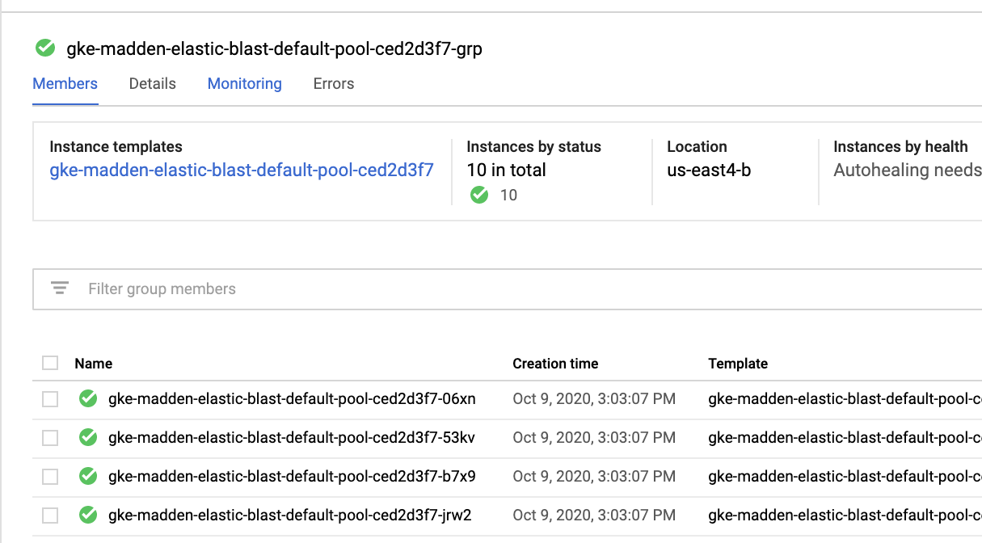
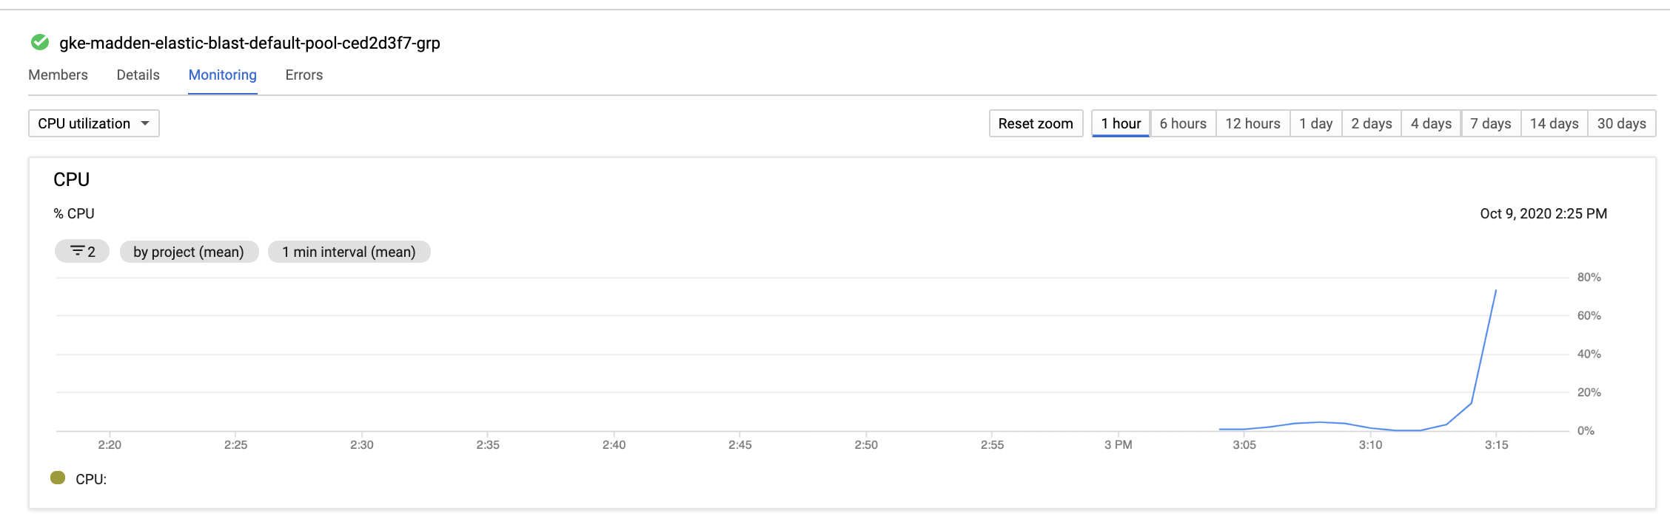
Monitoring

Slide 53
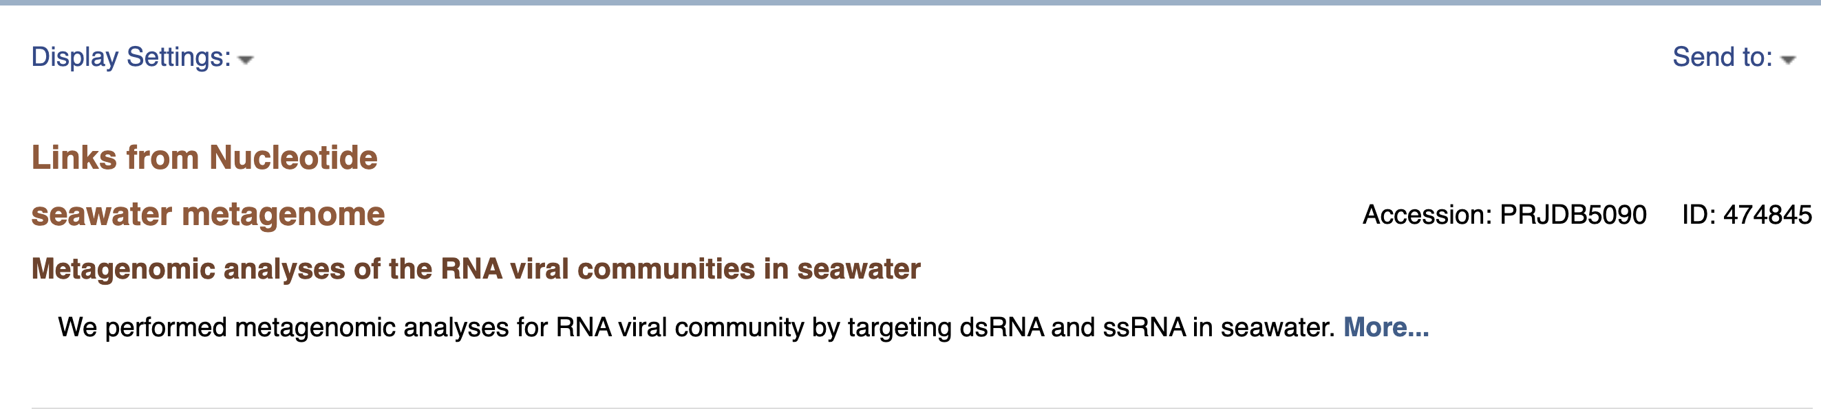
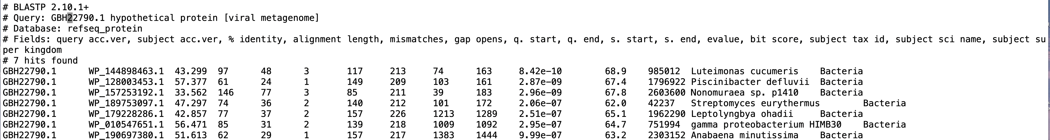
Looking for suspicious matches in our results.
Domain | Number
Virus | 549
Bacteria | 9
Eukaryota | 31

Slide 54
Want to try ElasticBLAST?
NCBI is looking for alpha testers
Interested? Please Contact Dave Arndt at arndtdj@nih.gov

Slide 55
Acknowledgements ElasticBLAST Team
Christiam Camacho
Yuri Merezhuk
Yan Raytselis
Amelia Fong
Irena Zaretskaya
Dan Soren
Greg Boratyn
Victor Joukov
Anatoliy Kuznetsov
Vadim Zalunin
Roberta Vera Alvarez
Dave Arndt
Scott McGinnis
Peter Cooper
Wayne Matten
Tao Tao
Valerie Schneider
Rodney Brister
Eugene Yaschenko
Kim Pruitt
Steve Sherry
This research was supported by the Intramural Research Program of the NIH, National Library of Medicine.

Slide 56
Annotation pipelines
Annotation in the biological analysis workflow
What is stand-alone the Prokaryotic Genome Annotation Pipeline (PGAP)?
Start-to-finish annotation with PGAP
The Read Assembly and Annotation Pipeline Tool (RAPT) = assembly + annotation
Start-to-finish assembly and annotation with RAPT
https://github.com/ncbi/pgap
https://github.com/ncbi/rapt

Slide 57
Importance of gene annotation in whole-genome analyses
Determination of gene location and function
Precursor of downstream analyses, including
Comparative genomics
Phylogenetic trees
Exploration of biochemical pathways
Virulence factor discovery
…
Assessment of sample or assembly quality

Slide 58


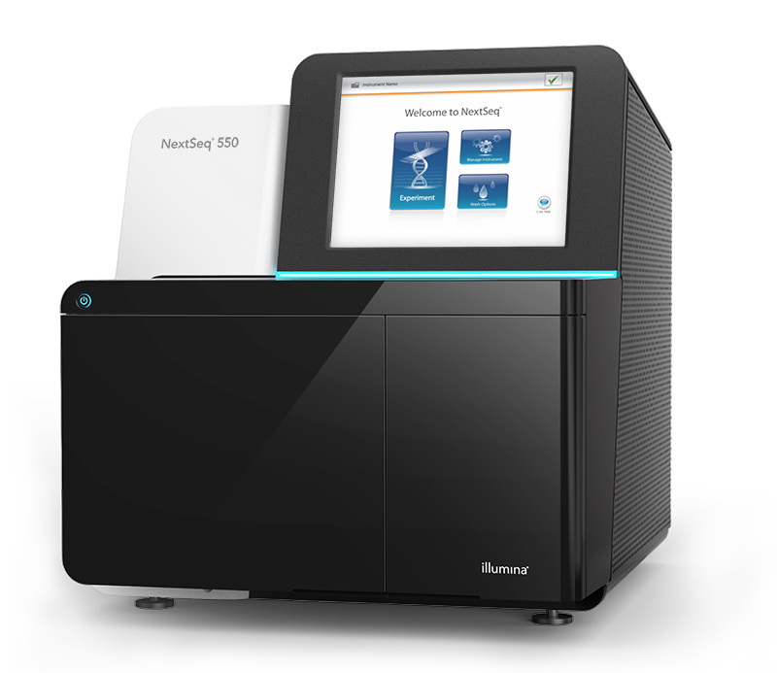
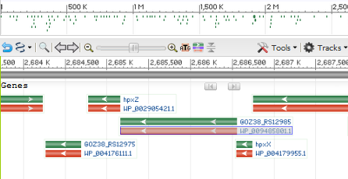




PGAP and RAPT in a typical workflow
>tig00000001
TTTGTTCAGGAGTATGCGCCGCCGACATCTGGGTGCGAATACGCGCACGGCCTTTCGGTACCACCGGATGAAGAAGTGACATAGATCCTTCTTTCTGCG
Collect DNA
Sequence
Assemble
Annotate
Review
Analyze
SKESA
PGAP
RAPT
What does RAPT do?
Assembles a genome from Illumina short reads sequenced from a bacterial or archaeal isolate, using SKESA
Annotates the genome with PGAP, the pipeline used to annotate RefSeq genomes
What does PGAP do?
Annotates the genome with PGAP, the pipeline used to annotate RefSeq genomes

Slide 59
Why run PGAP yourself?
Proprietary genomes
Quick characterization of starting material
Assembly QC
Large volume
Comparison to PGAP-annotated RefSeq assemblies

Slide 60


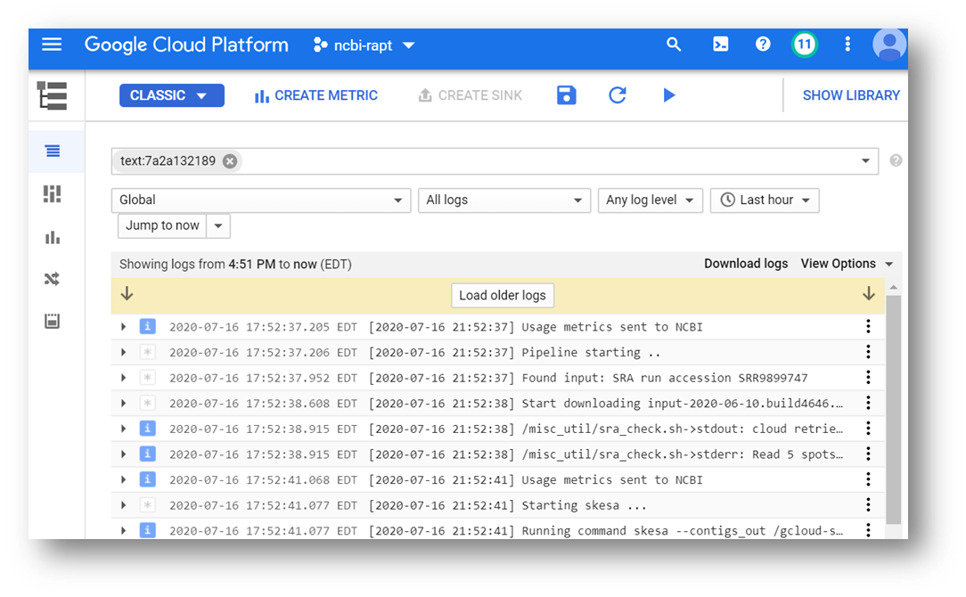

GCP RAPT Workflow Overview
Starts a virtual machine
Downloads and instantiates
the RAPT Docker container
From the Google Console
Sends execution logs to Google Stackdriver
Sends results to Google
storage bucket
Requirements
GCP account and project with a quota of at least 16 CPU in a given region
A Google storage bucket
Shuts down the virtual machine

Slide 61
Coming next….
RAPT and PGAP are on github
Subscribe and stay informed of new releases
https://github.com/ncbi/pgap
https://github.com/ncbi/rapt
By late 2020
Performance improvements in PGAP and RAPT
A web service for RAPT

Slide 62
We want your feedback !
Will these tools be useful to your research?
What other tools would help you reach your goals?
How do you use annotated genomes?
What computing environment do you have access to?
Are you interested in getting sneak previews of new tools or features, and in becoming a tester?
Send email to the team responsible
prokaryote-tools@ncbi.nlm.nih.gov

Slide 63
Acknowledgements PGAP/RAPT
David Arndt
Azat Badretdin
Slava Chetvernin
Rob Cohen
Wratko Hlavina
Wenjun Li
Shennan Lu
Peter Meric
Eyal Mozes
Douglas Slotta
Daniel Soren
Deacon Sweeney
Lukas Wagner
Mingzhang Yang
Ben Busby
Lewis Geer
Jim Ostell
Kim Pruitt
Eugene Yaschenko
Steve Turner
This research was supported by the Intramural Research Program of the NIH, National Library of Medicine

